Slide 1
Graffiti Art
Inspired by the world around you & what you want to communicate

Slide 2
Graffiti has existed since ancient times with examplesdating back to Ancient Greece and the Roman Empire. In modern times, spray paint, regular paint and markers are the most commonly used materials. Although the defacing of property is a crime punishable by law, many artists choose to express themselves this way.

Slide 3
Banksy has had much Success & Buildings with His Stenciled Pieces Have More Value

Slide 4
Look Familiar?

Slide 5
CarToons are a common Inspiration Source

Slide 6
An artist is trying to Make their style known

Slide 7
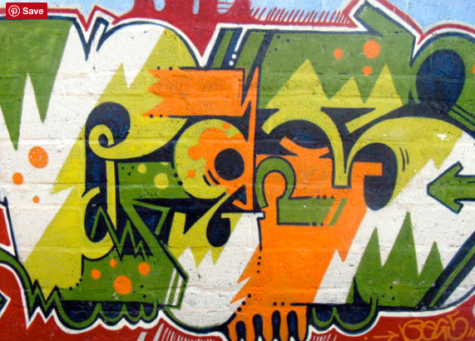

Slide 8
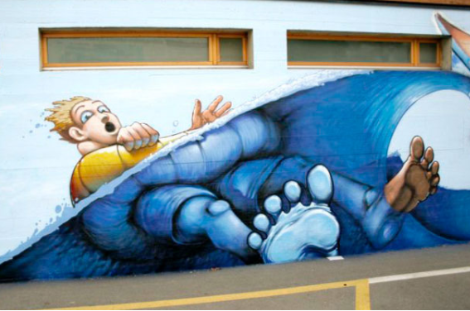

Slide 9
Start by Drawing a Brick Wall For The Background
Draw Lightly

